Slide 1
Improving Performance of K-Means on Spark
Manoj Reddy & Tushar Sudhakar
CS 239 – Spring 2016

Slide 2
K-Means
Most popular clustering algorithm
Input: k, initial centers, datapoints
Two simple steps:
Assignment
Assign each point to the closest center using Euclidean distance
Update
Compute the means by computing the average of the points assigned to a center
Convergence criteria:
Maximum number of iterations
Center difference falls below a threshold

Slide 3
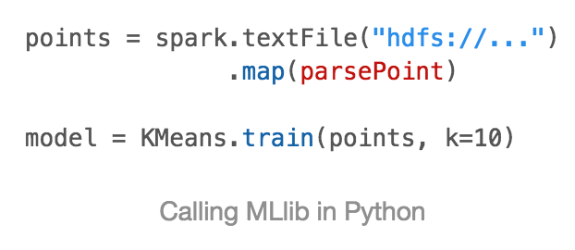
MLlib
Spark’s Machine Learning library
Contains popular classification, clustering algorithms
Kmeans:

Slide 4
Implementation – MLlib
Master
Centers
Slave 1
Slave 2
Slave 3
Closest center calculated for each point
Partial sum and count computed
Reduce
Update centers

Slide 5
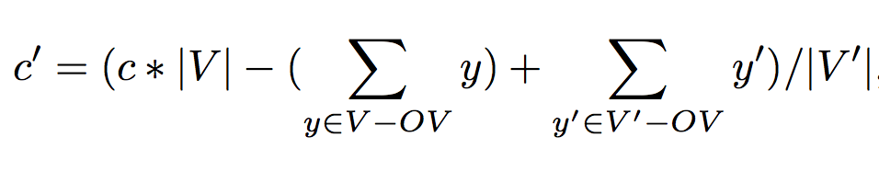
Optimizations
Most points don’t change cluster assignment between iterations
Optimize partial sum computation
Involves fewer computations
Requires storing information about cluster assignment
V’ – points assigned in current iteration
V – points assigned in previous iteration
OV – points that overlap between iterations

Slide 6
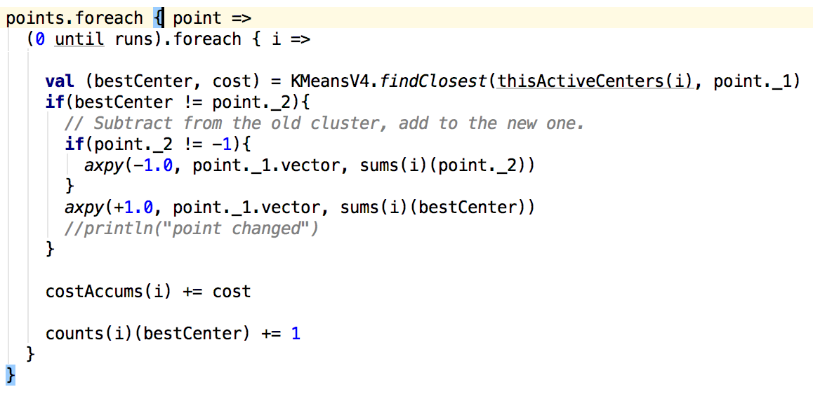
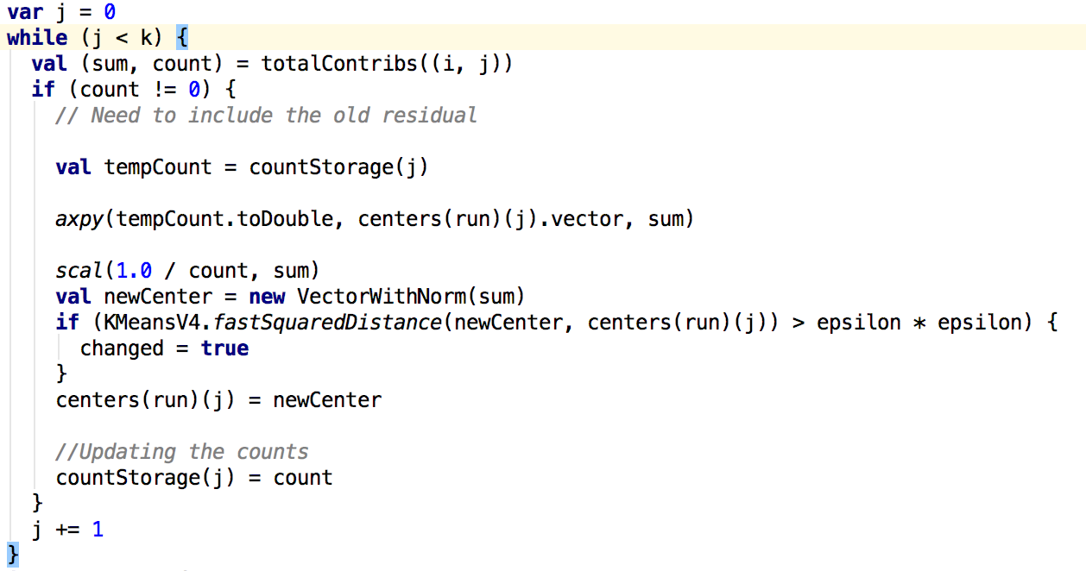
Implementation
Initially, map each point to a (point, cluster assignment) pair
Repeatedly apply map on the RDD in every iteration to change the cluster assignment
Subtracting from old center and adding to new one
Adding old sum

Slide 7
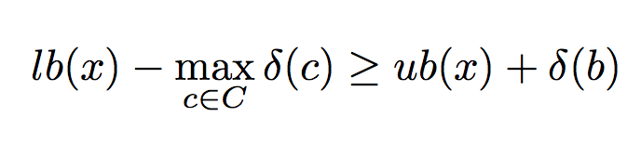
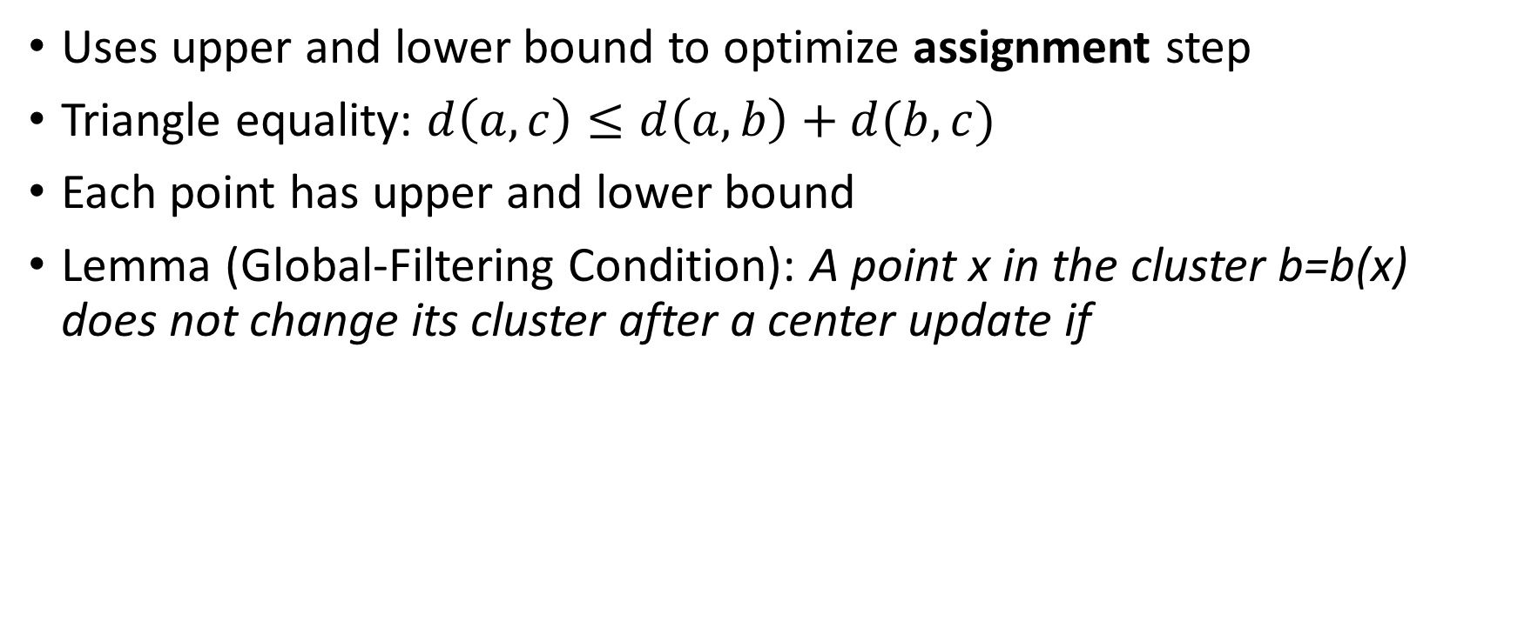
Yinyang K-Means (ICML 2015)
Uses upper and lower bound to optimize assignment step
Triangle equality: $d\left(a,c\right)≤d\left(a,b\right)+d(b,c)$
Each point has upper and lower bound
Lemma (Global-Filtering Condition): A point x in the cluster b=b(x) does not change its cluster after a center update if

Slide 8
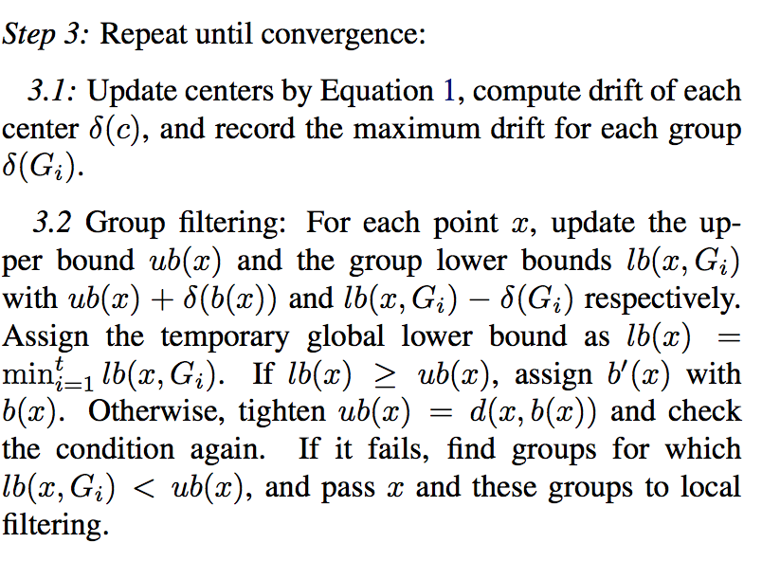
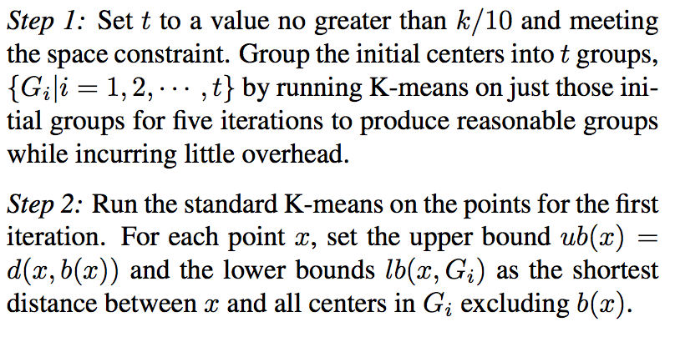
Yinyang Algorithm (sic. paper)

Slide 9
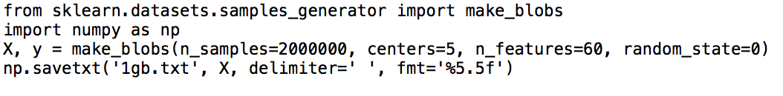
Datasets
Generated using make_blobs()
Scikit-learn library in Python
Simply specify:
Number of points, dimensions

Slide 10
Demo

Slide 11
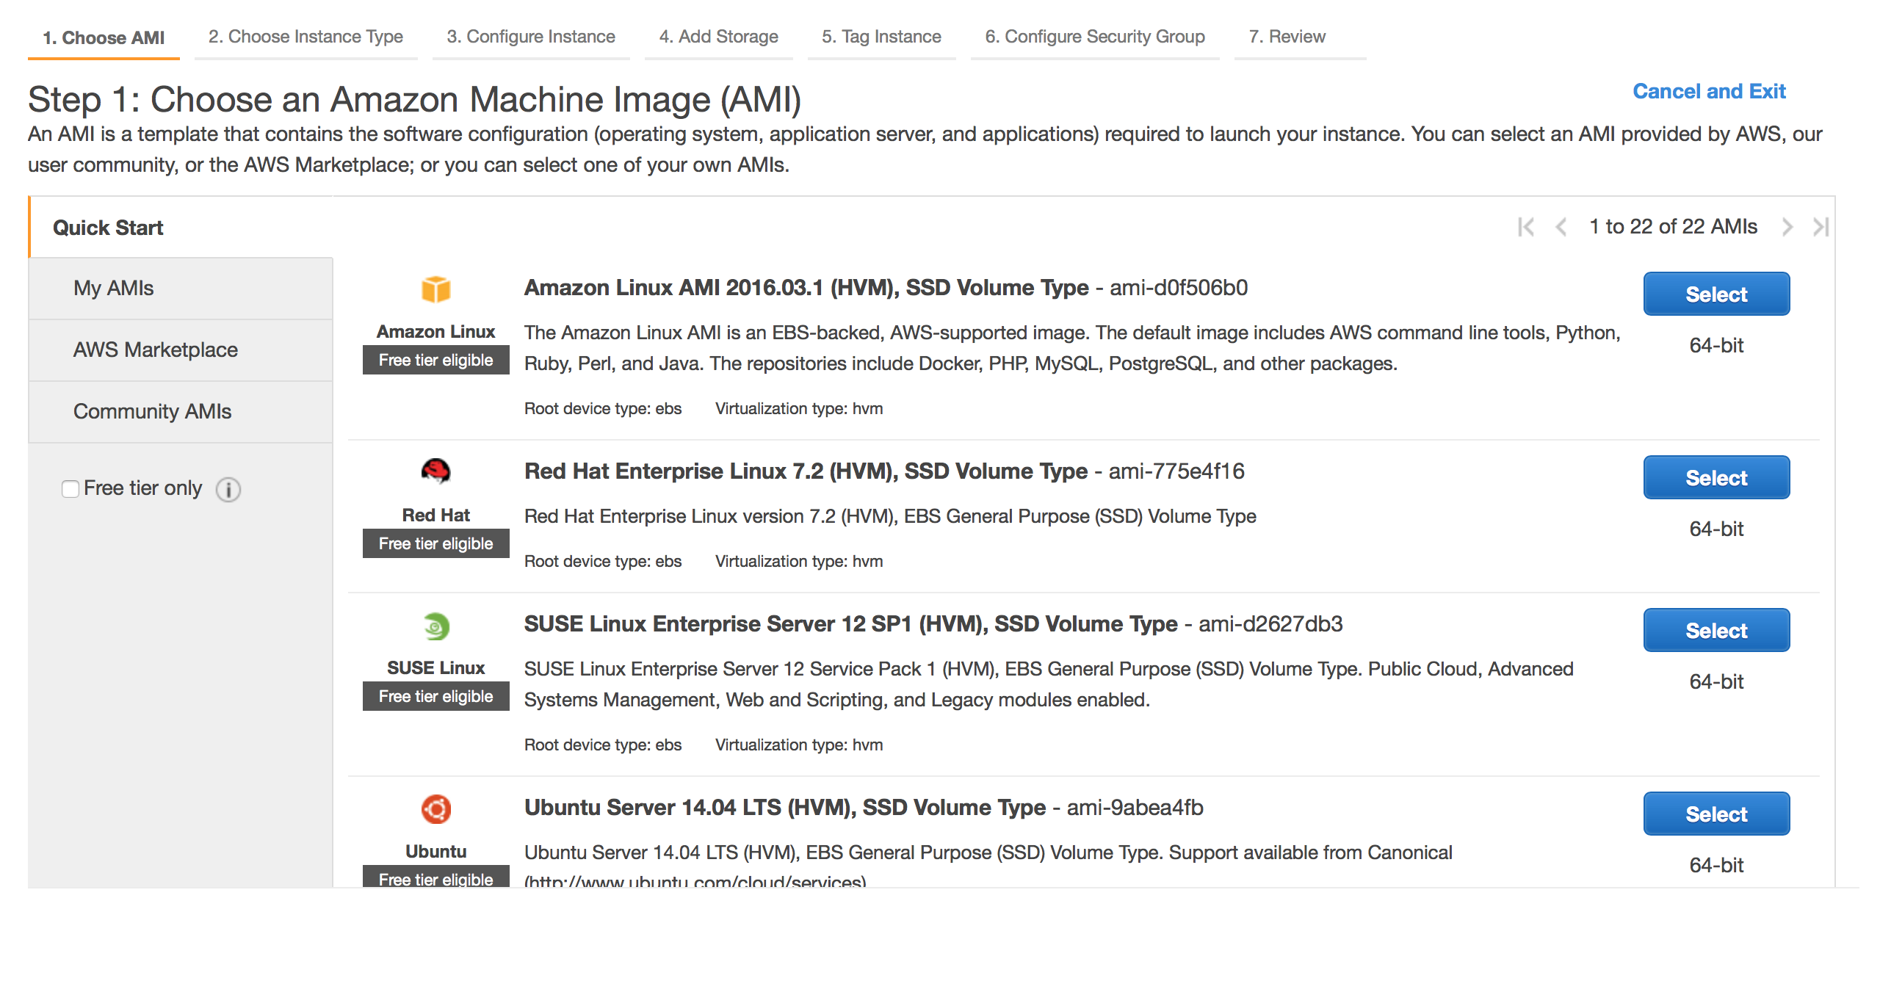

Slide 12
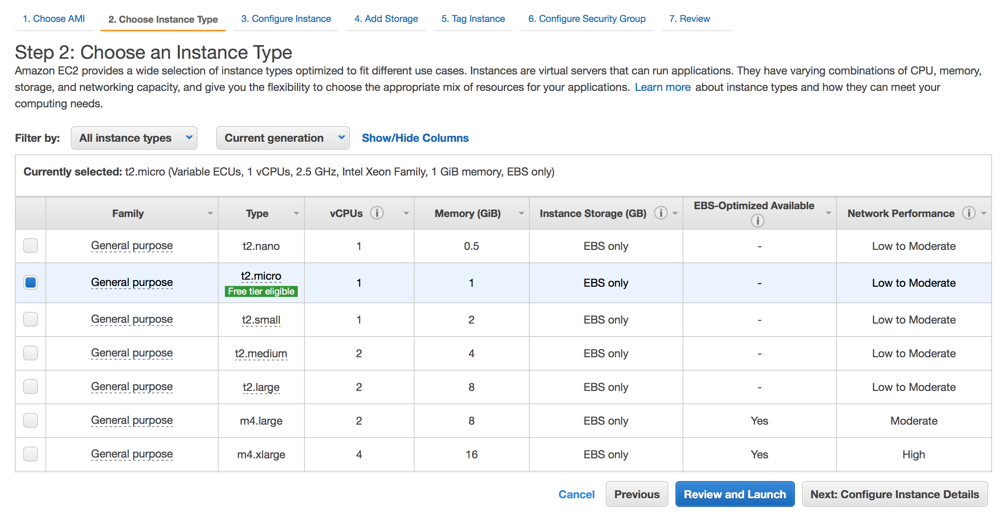

Slide 13
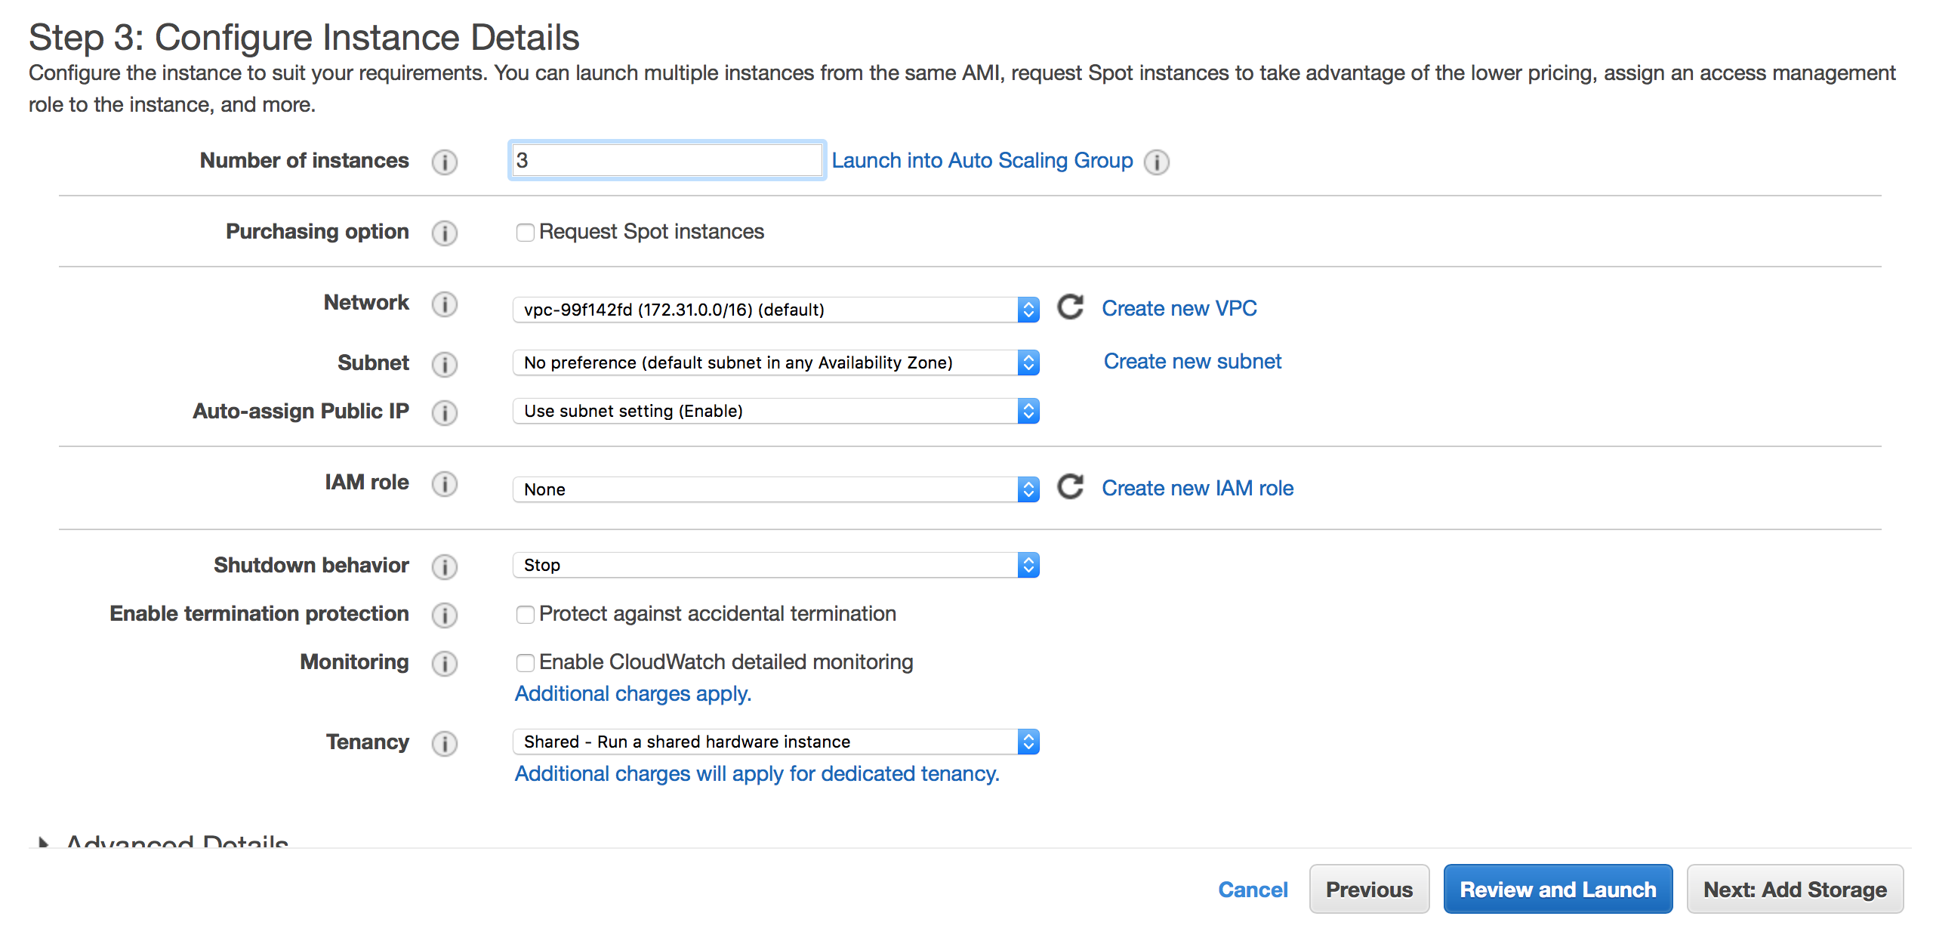

Slide 14
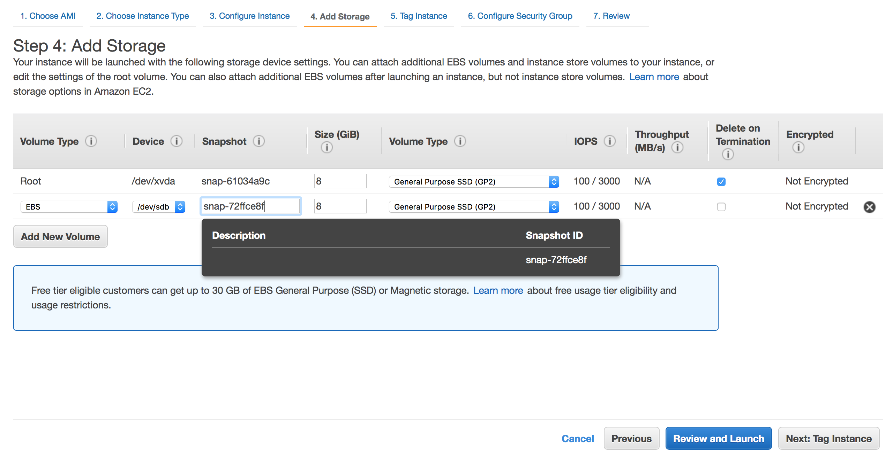

Slide 15
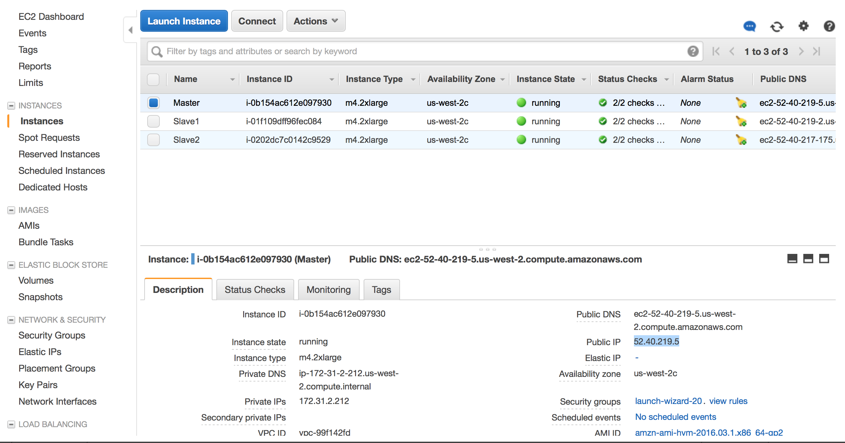

Slide 16
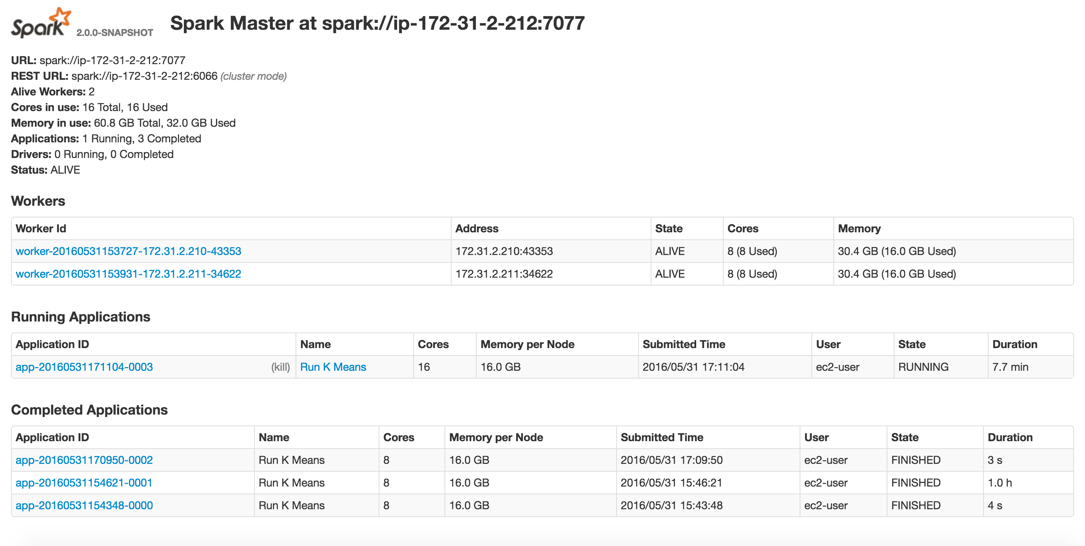

Slide 17
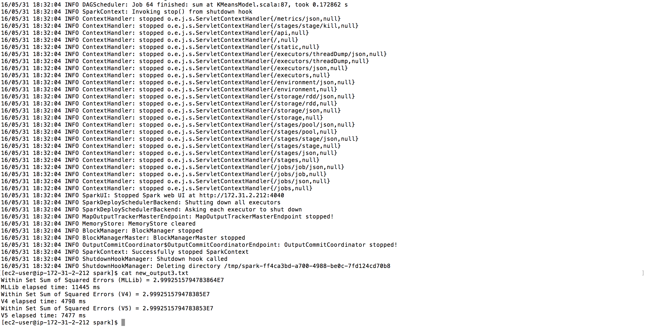

Slide 18
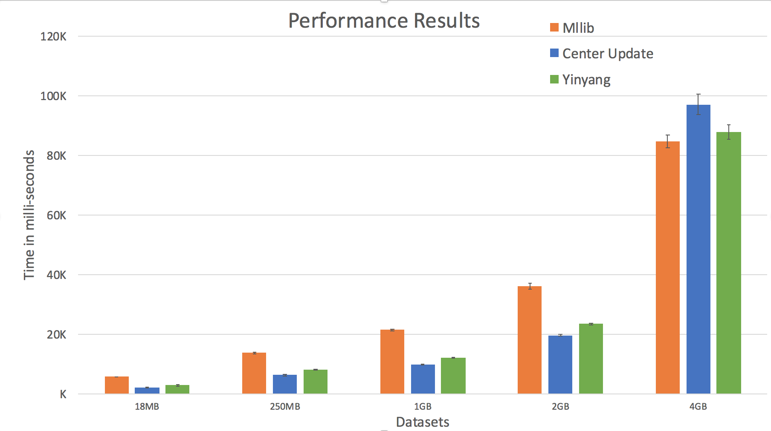
Results on EC2

Slide 19
Discussion
Modified the MLlib’s codebase and added 2 new versions
Learnt a lot about of Spark
Spent enormous time on Amazon EC2
Speedup of 1.98x for center update
Speedup of 1.6x for Yingyang K-Means

